Slide 1

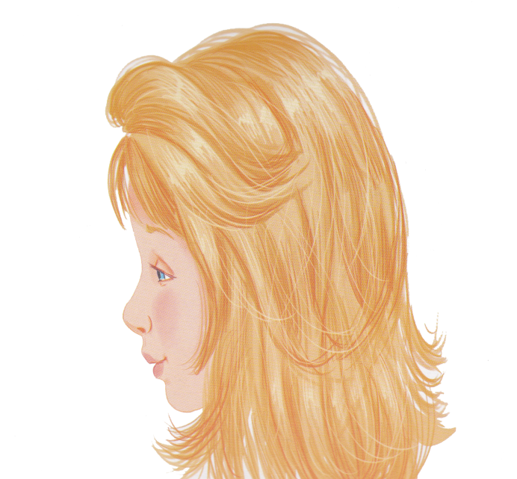
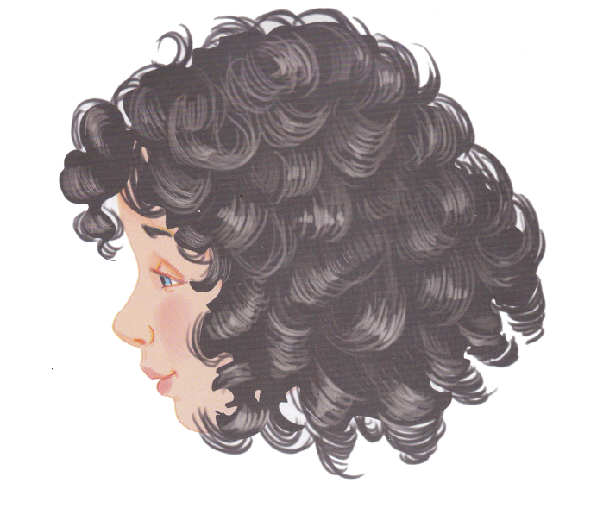
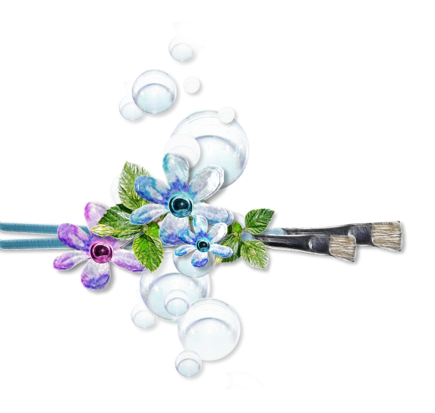
The theme
of our lesson is ‘Appearance’.
Today we are going to listen to the dialogues, to read the text and
to refresh the using of the verb have got. And we shall train to describe people.

Slide 2

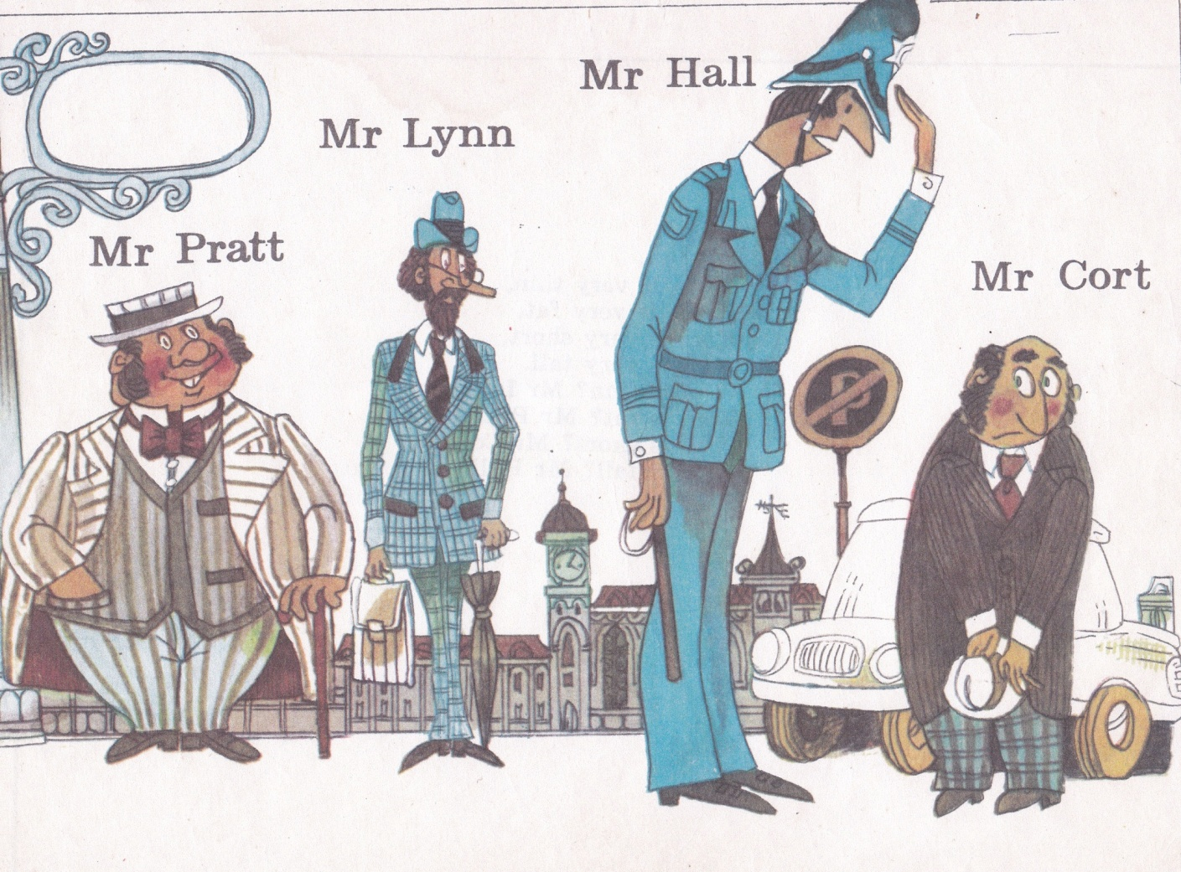
Poem “Mr. Pratt”
Mr. Pratt is very fat.
Mr. Lynn is very thin.
Mr. Hall is very tall.
Mr. Cort is very short.
Who is fat? Mr. Pratt.
Who is thin? Mr. Lynn.
Who is tall? Mr. Hall.
Who is short? Mr. Cort.

Slide 3

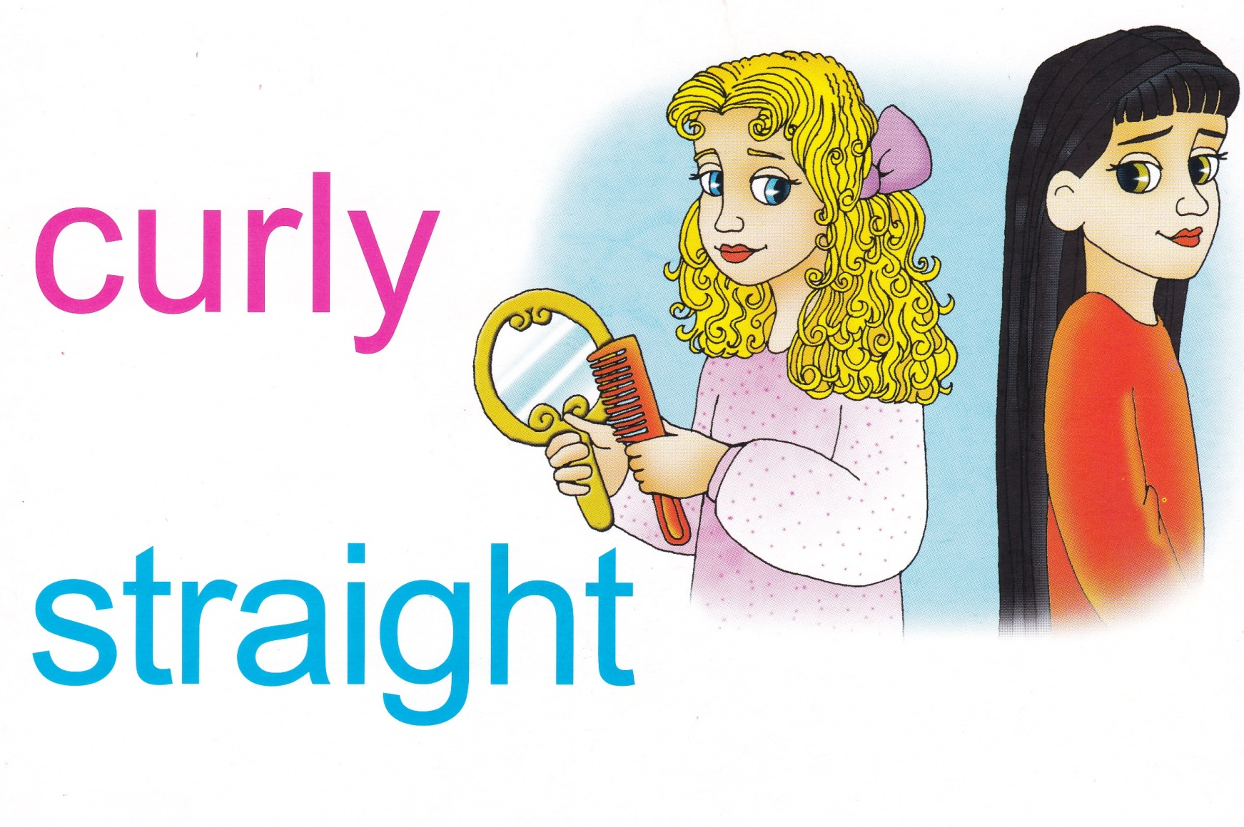
Revising the words with pictures and making own sentences

Slide 4
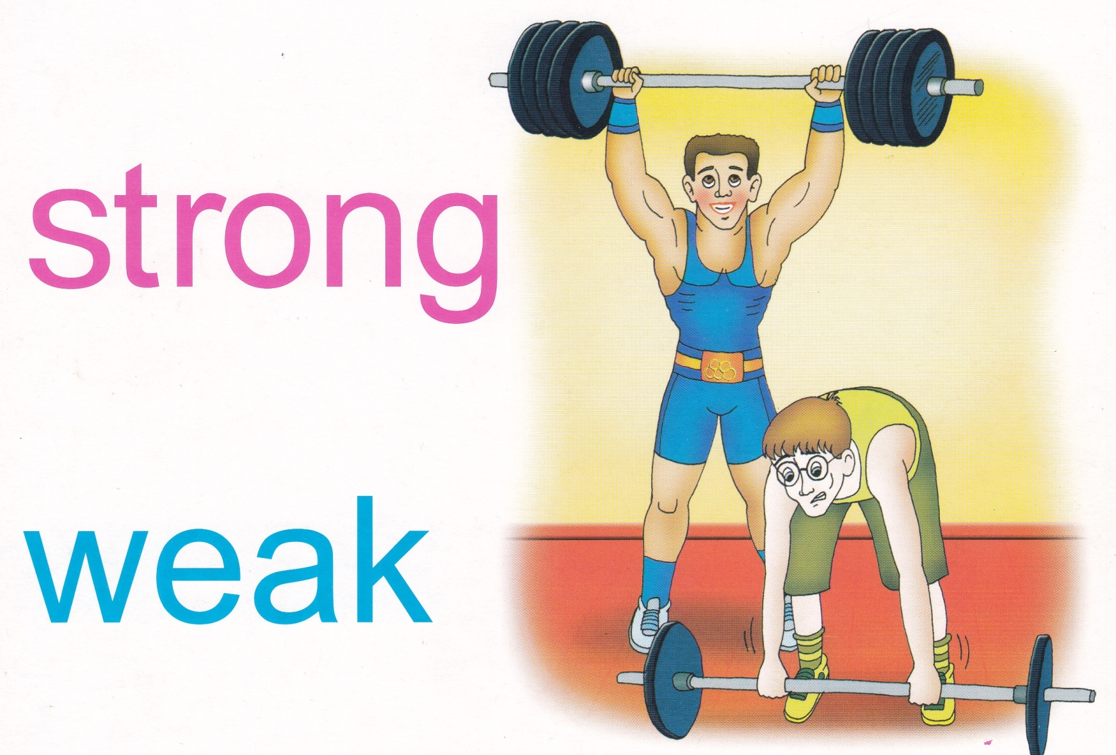
Revising the words with pictures and making own sentences

Slide 5
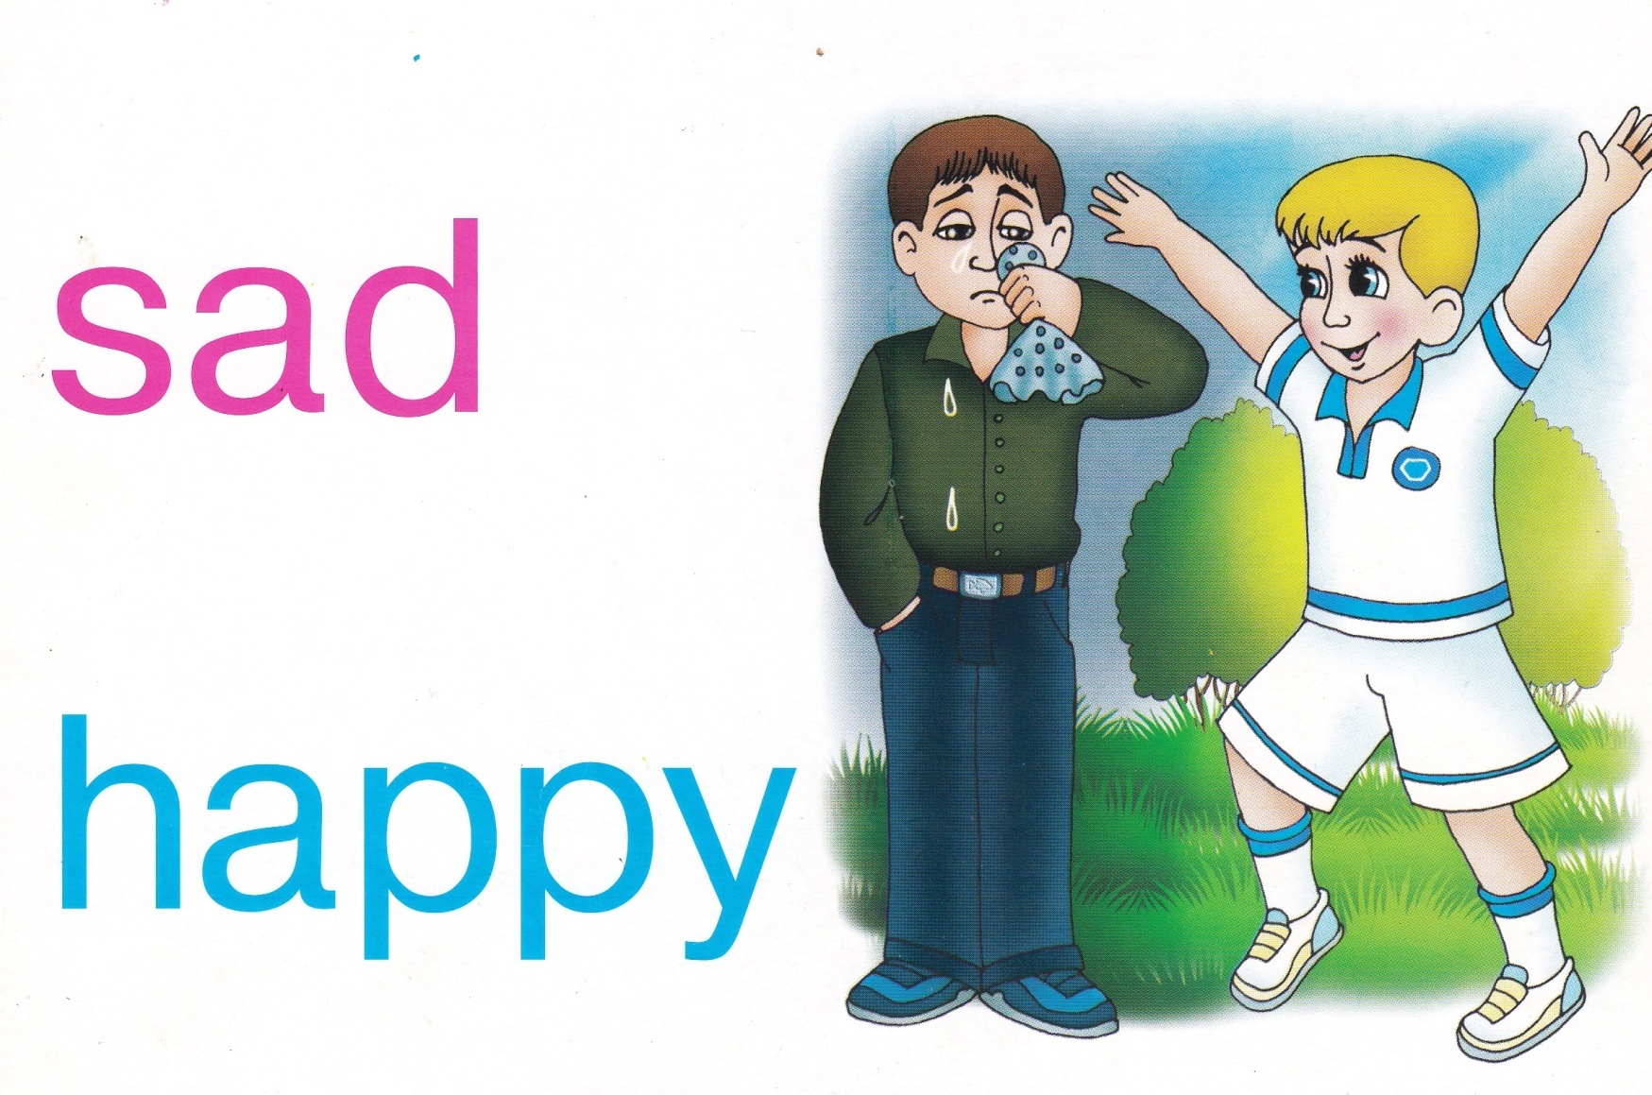
Revising the words with pictures and making own sentences

Slide 6
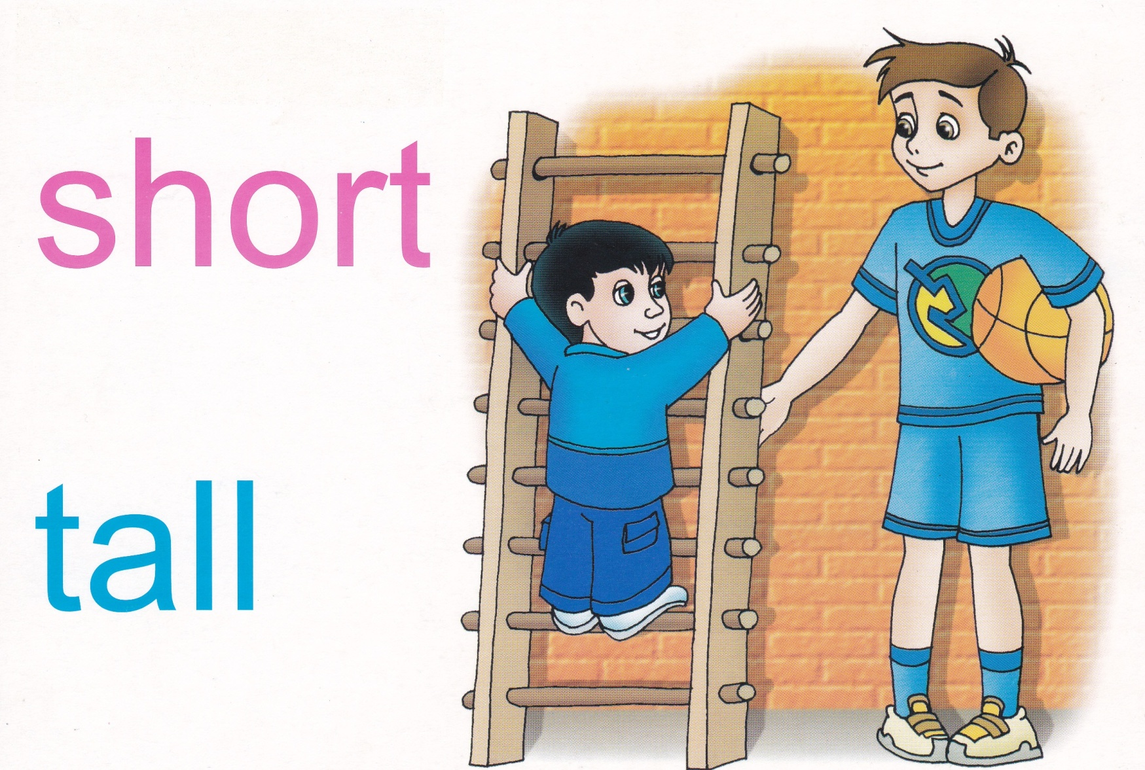
Revising the words with pictures and making own sentences

Slide 7
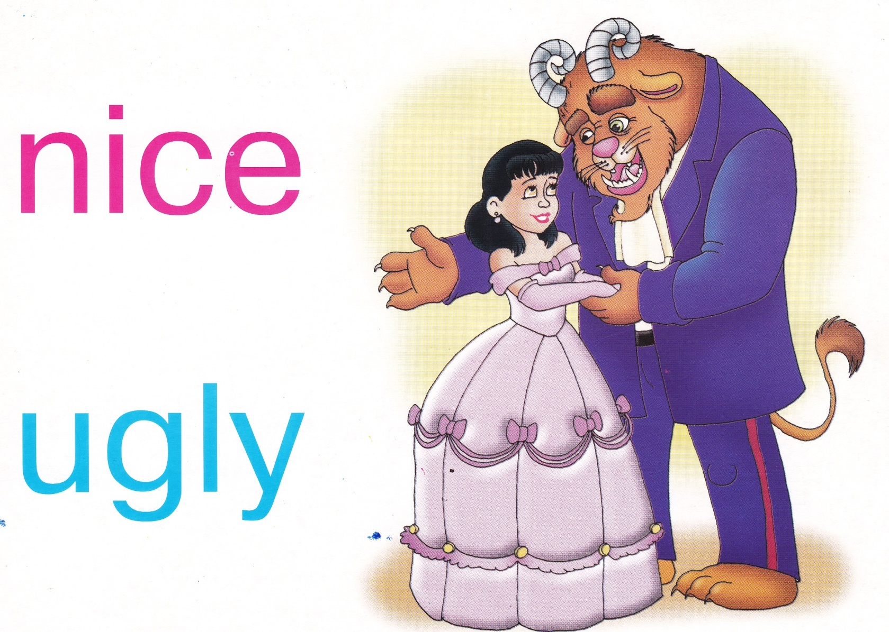
Revising the words with pictures and making own sentences

Slide 8
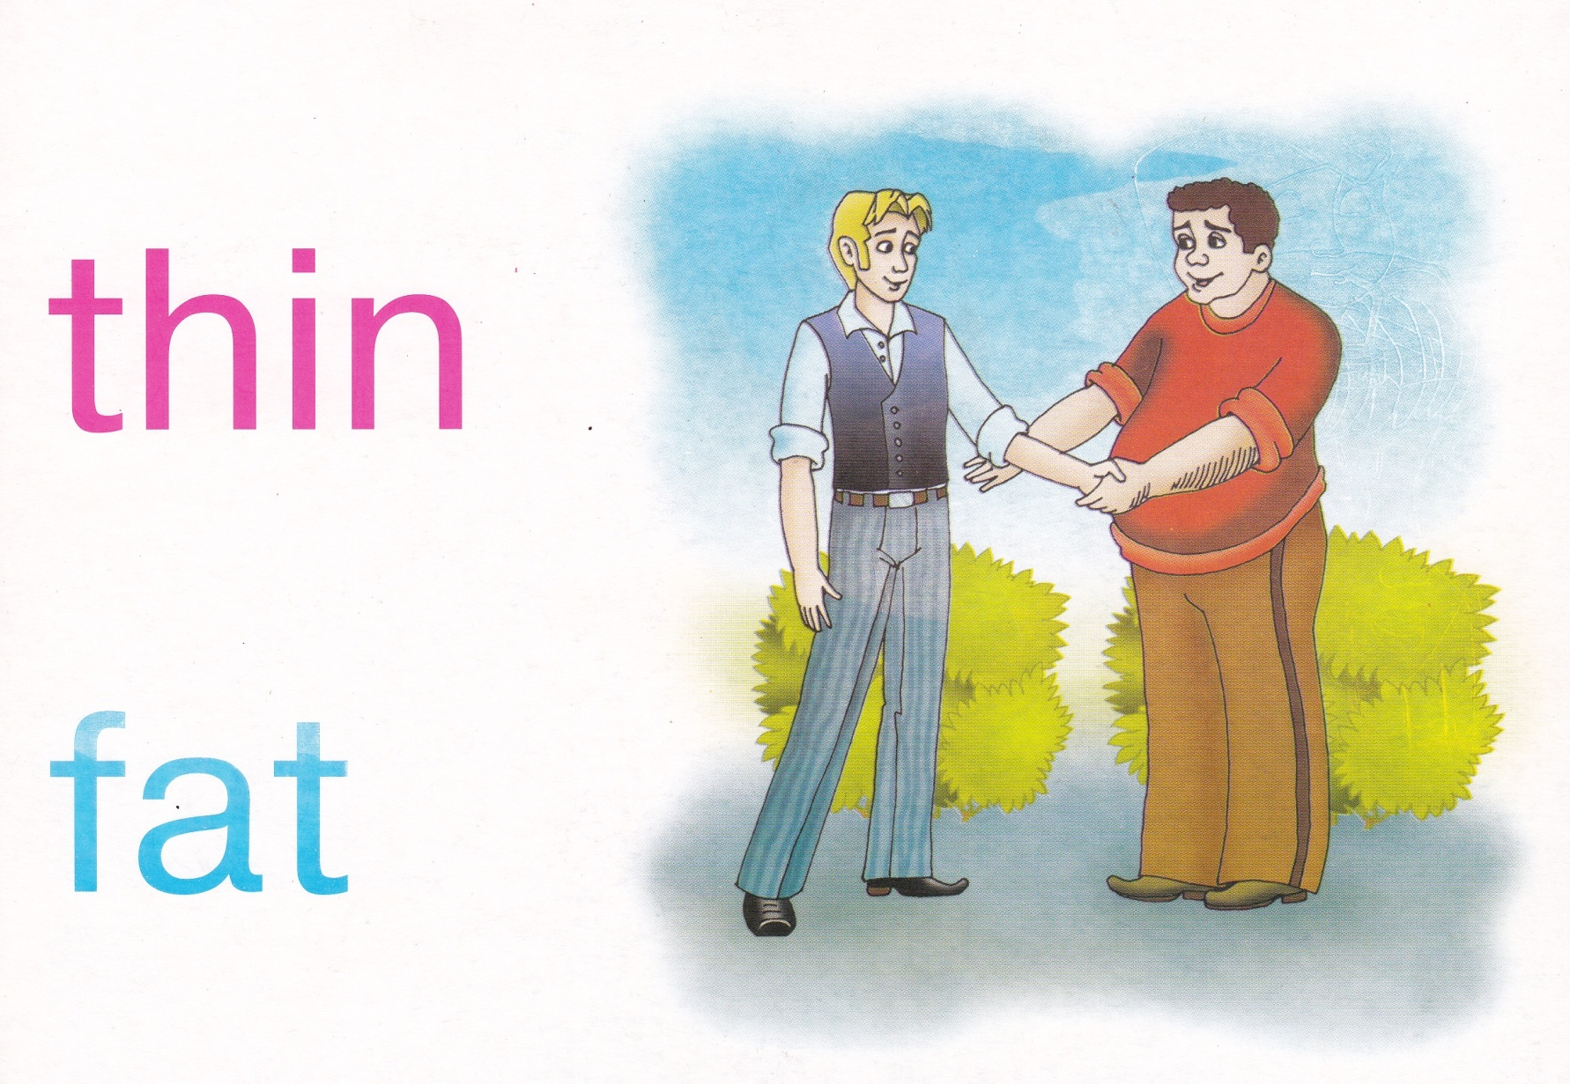
Revising the words with pictures and making own sentences

Slide 9
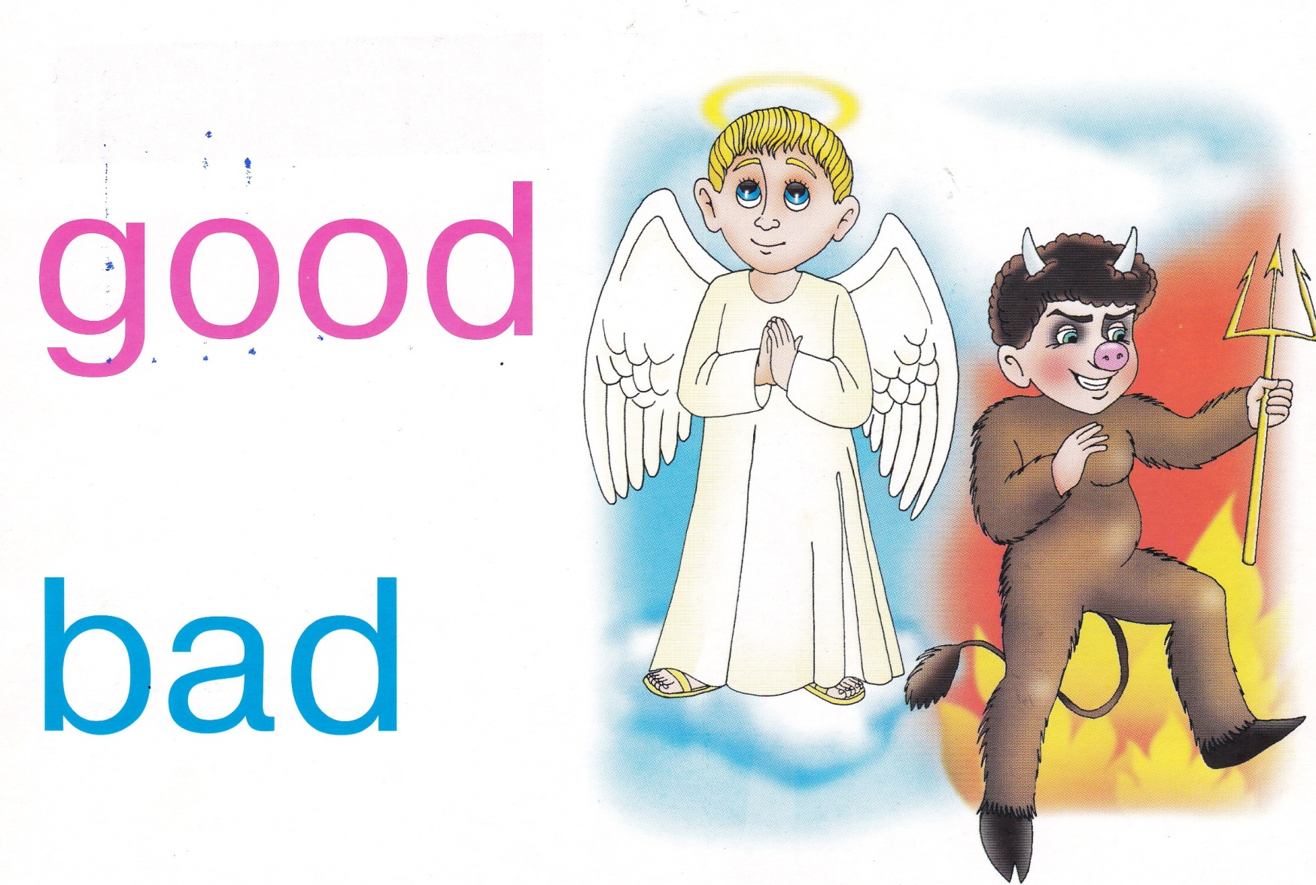
Revising the words with pictures and making own sentences

Slide 10
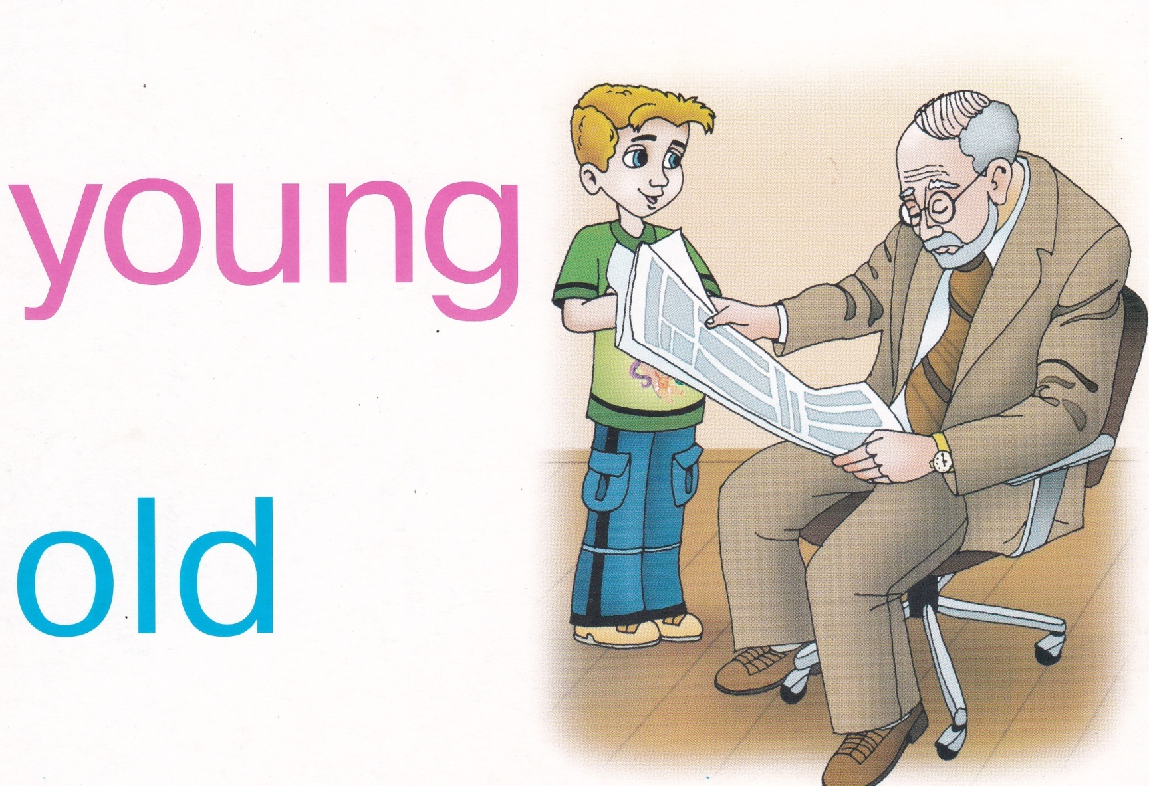
Revising the words with pictures and making own sentences

Slide 11
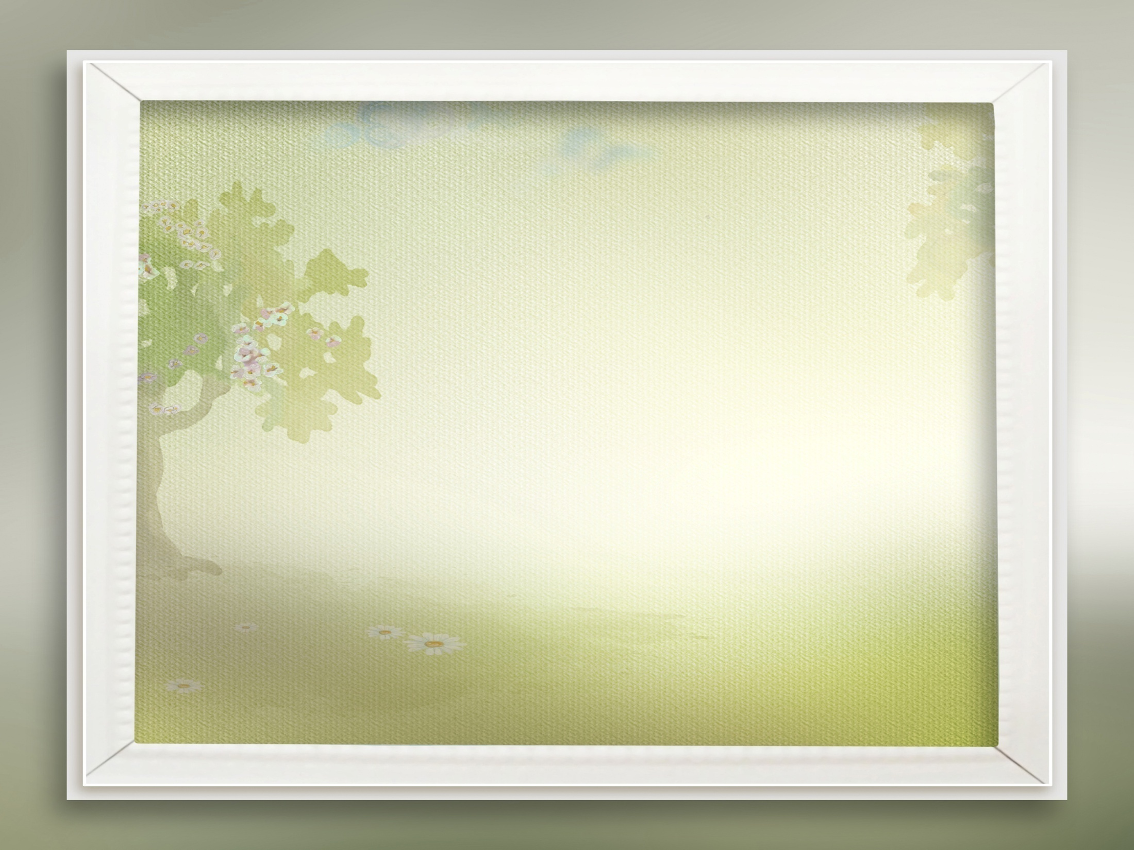
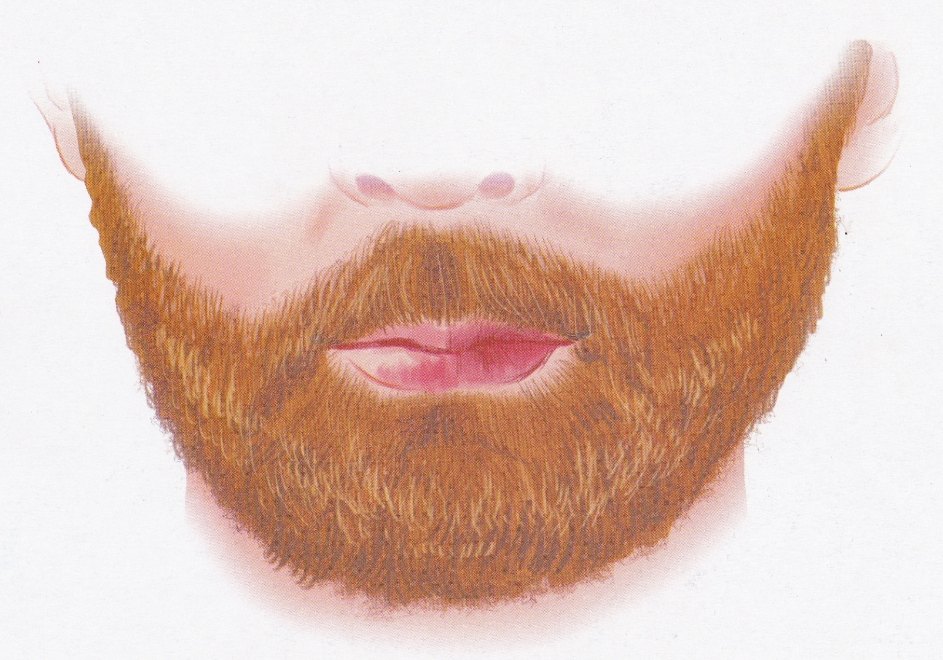

Slide 12
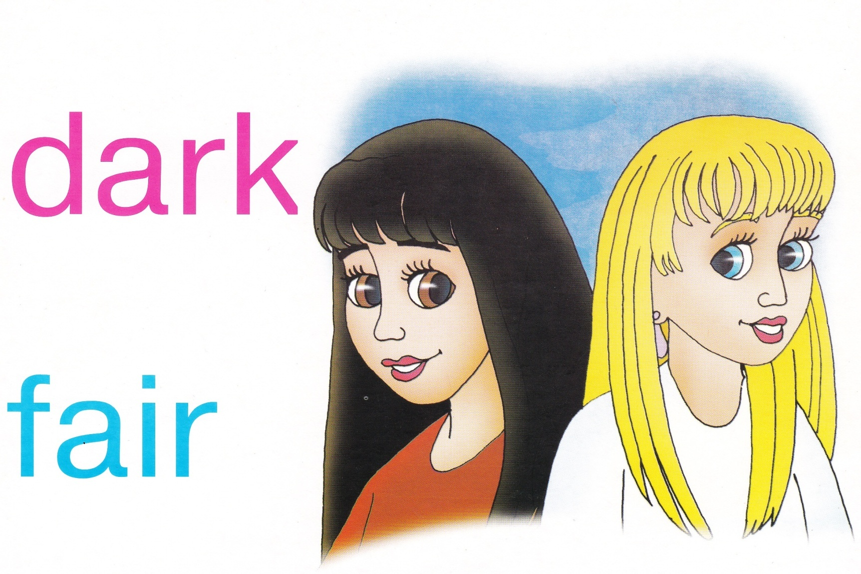
Revising the words with pictures and making own sentences

Slide 13
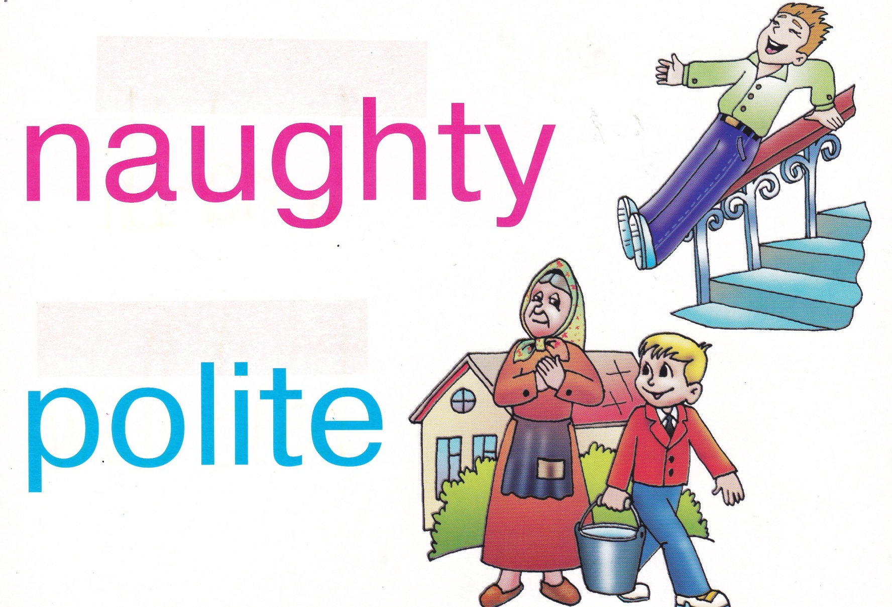
Revising the words with pictures and making own sentences

Slide 14




Match the opposites
(blackboard)
Young short
Short dark
Curly old
Blonde slim
Fat long
tall straight

Slide 15

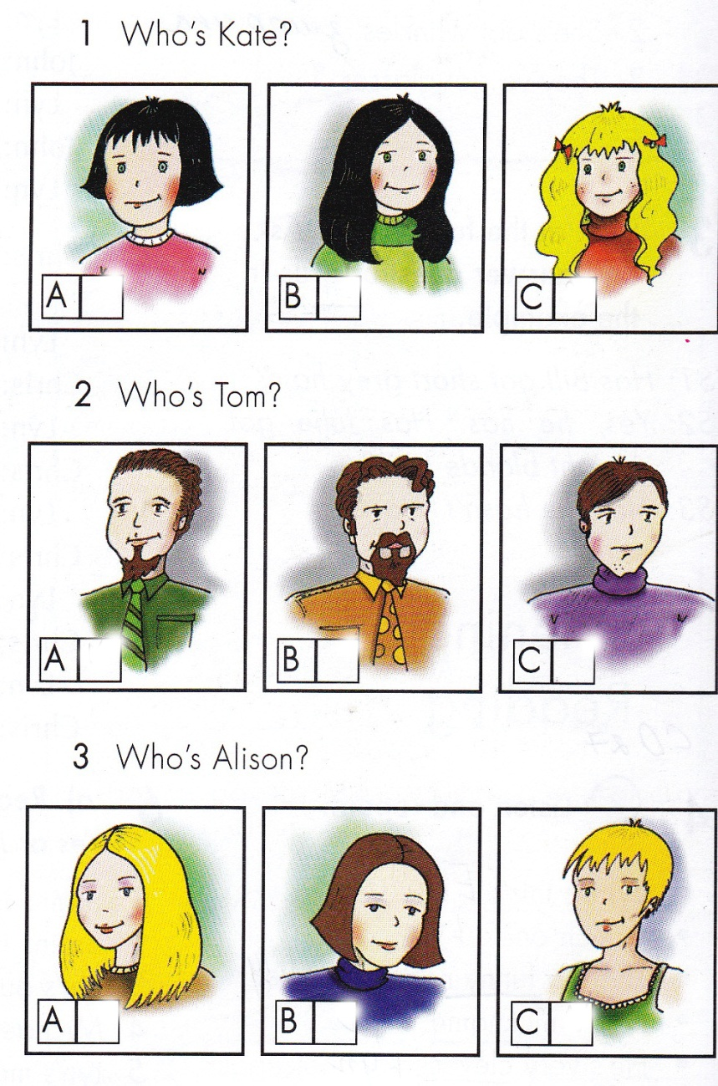
Listen to the dialogue
It is picture C
Прослухати діалог

Slide 16

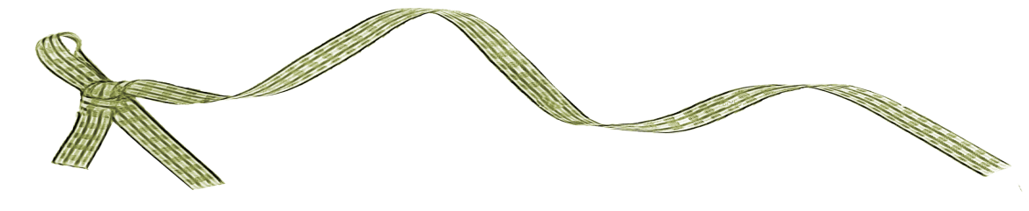
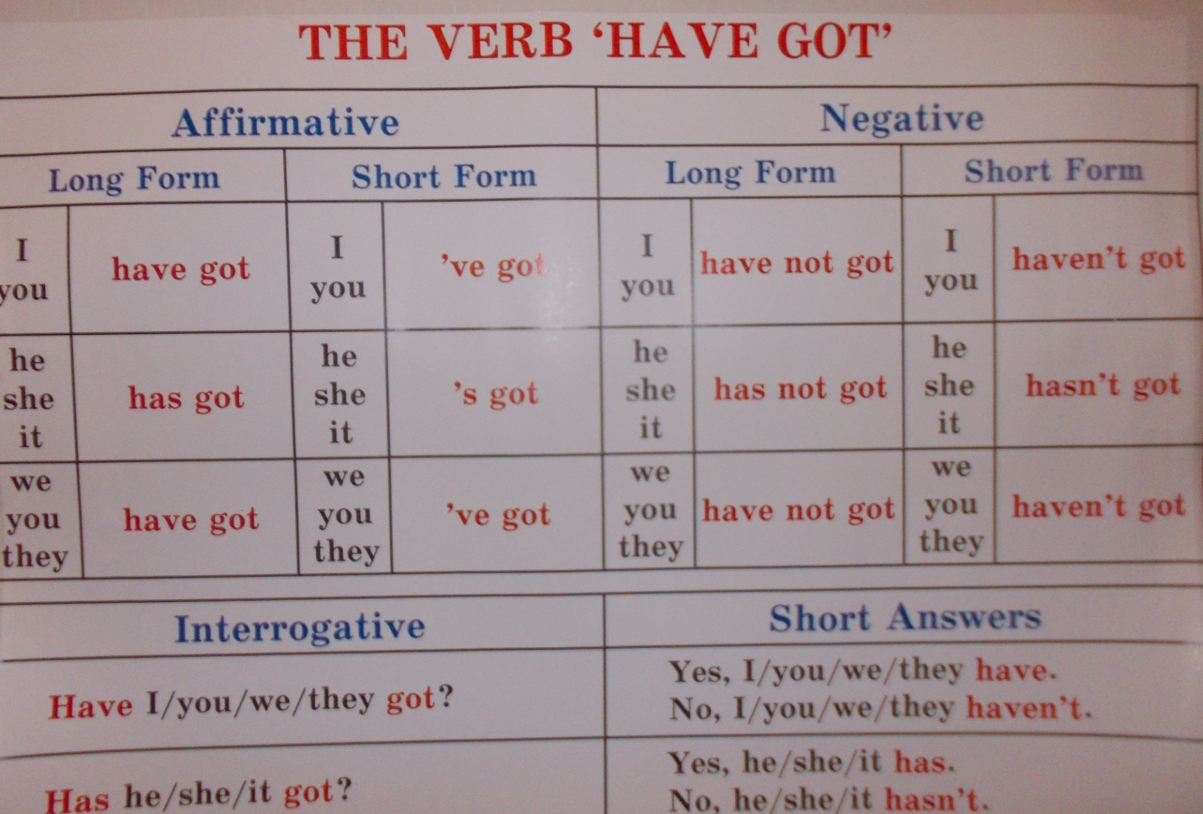


Slide 17
Fill in have, haven’t, has, hasn’t (blackboard)
I … got a TV, but I… got a computer.
Tom … got wrinkles.
… you got a brother?
Yes, I …, but I… got a sister.
The uncle … got dark curly hair.
My granny … got glasses. She can’t see well.

Slide 18
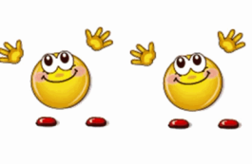

Фізкультхвилинка
музика

Slide 19
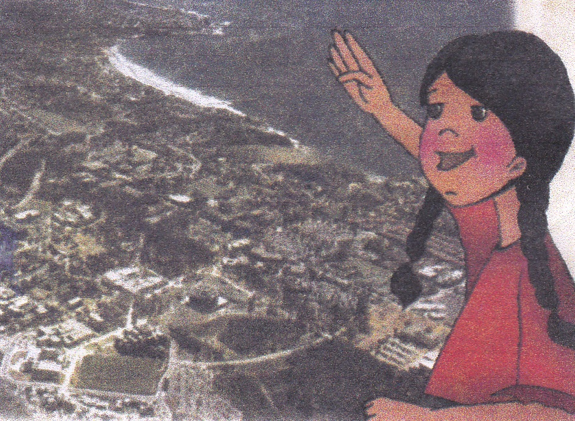
Hi!
My name is Helen. I am from the USA.
I have got straight dark hair and brown
eyes. I am tall and slim. Friends call me
Smiler. It is not my real name. It is my
nickname. They call me Smiler because
I am kind and friendly.
I have got a family. There are three
children in my family : two brothers,
Bill and Tom, and me. I have got two
pets, too. They are dogs. They are called
Rex and Blacky. I walk and feed them.
Have you got a pet?
Please write me about your family
and your pets.
Love. Helen.
True or false
Helen is from Canada.
She has got straight blonde hair.
Her eyes are brown.
She is tall and fat.
Helen has not got a nickname.
She is friendly.
There are tree children in her family.
Helen has two sisters.
Rex and Blacky are cats.

Slide 20
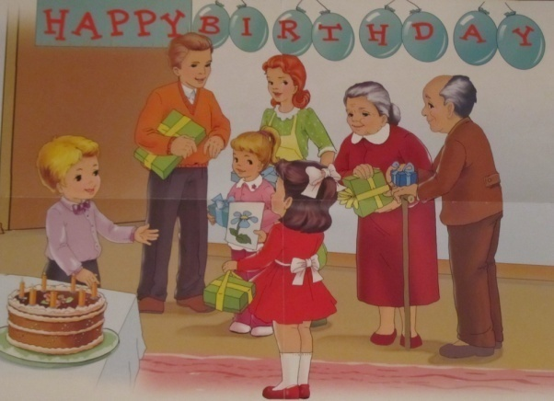
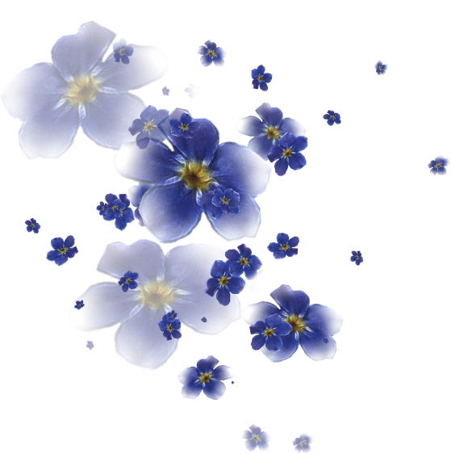

Describe one of the person using a picture “Happy Birthday” and sentences on the board.
This is … .
He /She is … (young/middle aged/old).
He /She is … (tall/of medium height/short).
He /She has got … (long/short/dark/blond(e)/grey/red) hair.
His/ Her hair is … (straight/curly/wavy).
His/ Her eyes are … (blue, green … ).
He / She is … (kind, friendly, clever, shy, funny…).

Slide 21


Slide 22
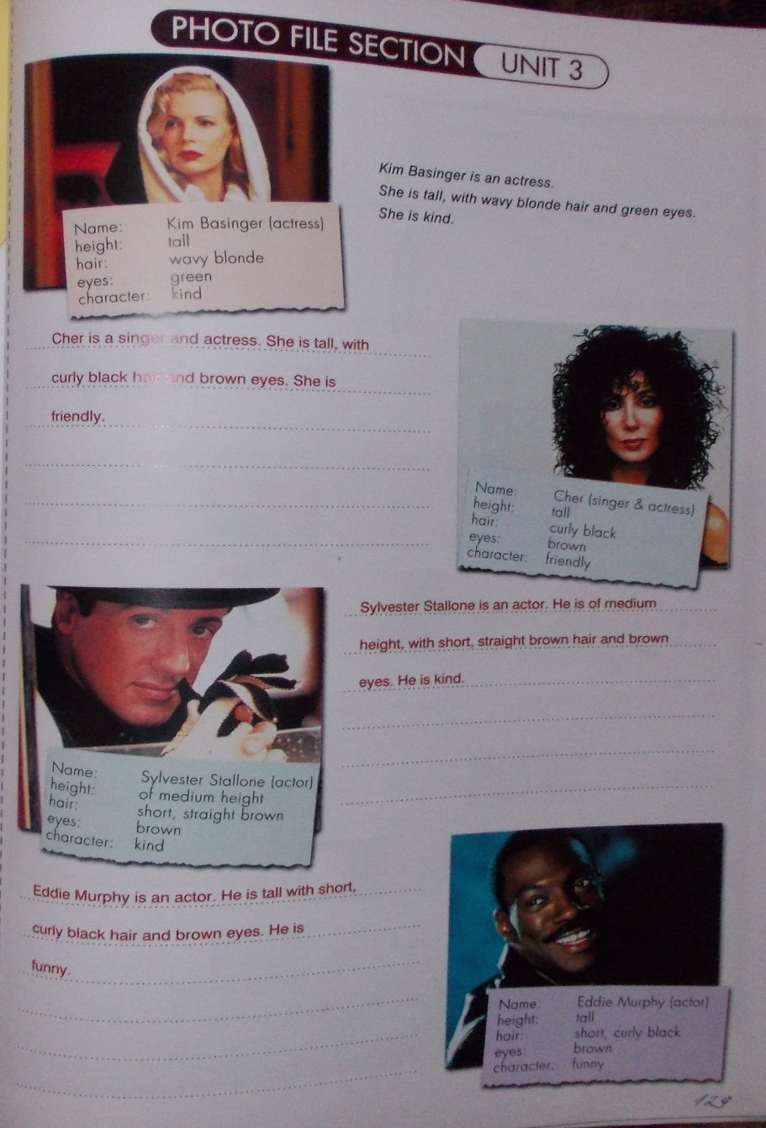
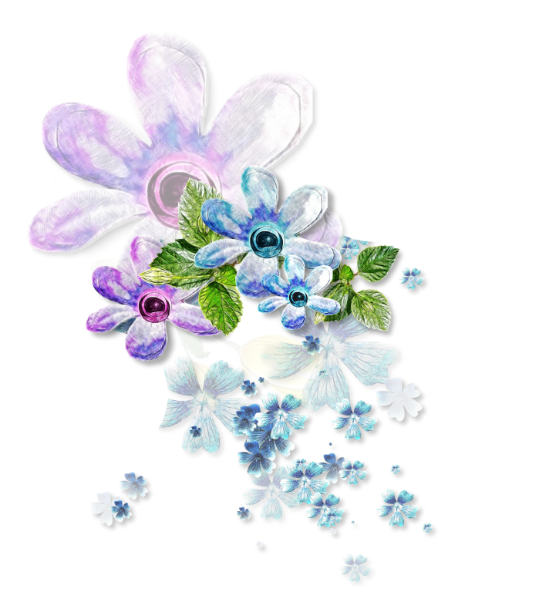
Project Work (SB p.129)
1. Answer the questions
1) Picture 1. What is the
woman’s name?
2) What is her job?
3) Is she tall or short?
4) What sort of hair has she got?
5) What colour eyes has she got?
What is she like?

Slide 23

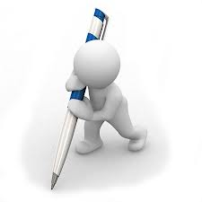
Homework
SB Project Work p. 129
(to end in a written form);
WB Ex.4, p. 13.

